Slide 1
LINUX
BHAVANA
DAY 5
05/04/2024

Slide 2
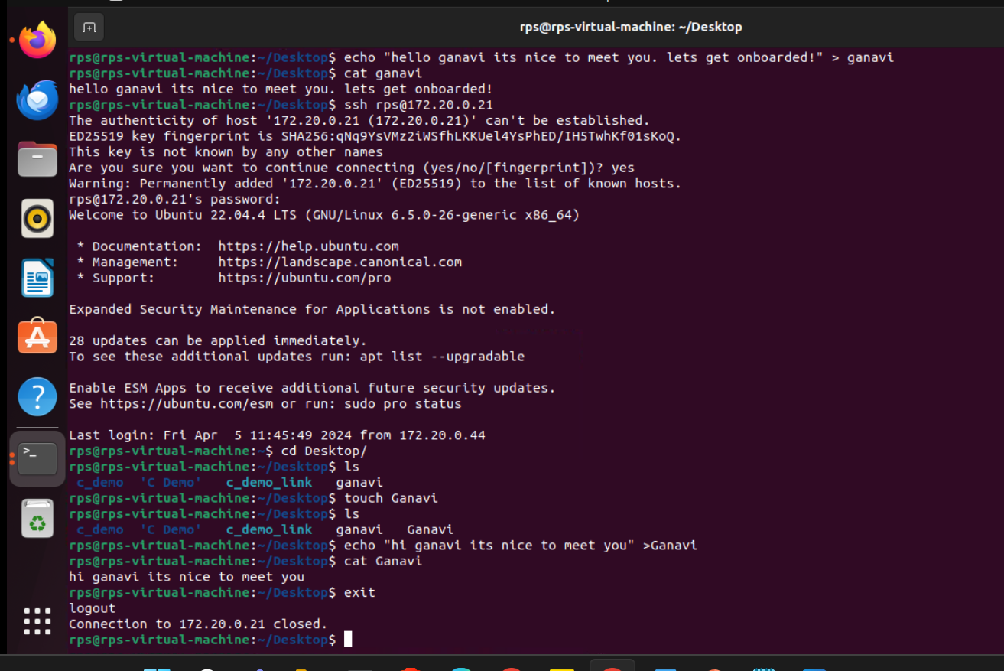
ACCESSING OTHER’S SYSTEM: USING ssh

Slide 3
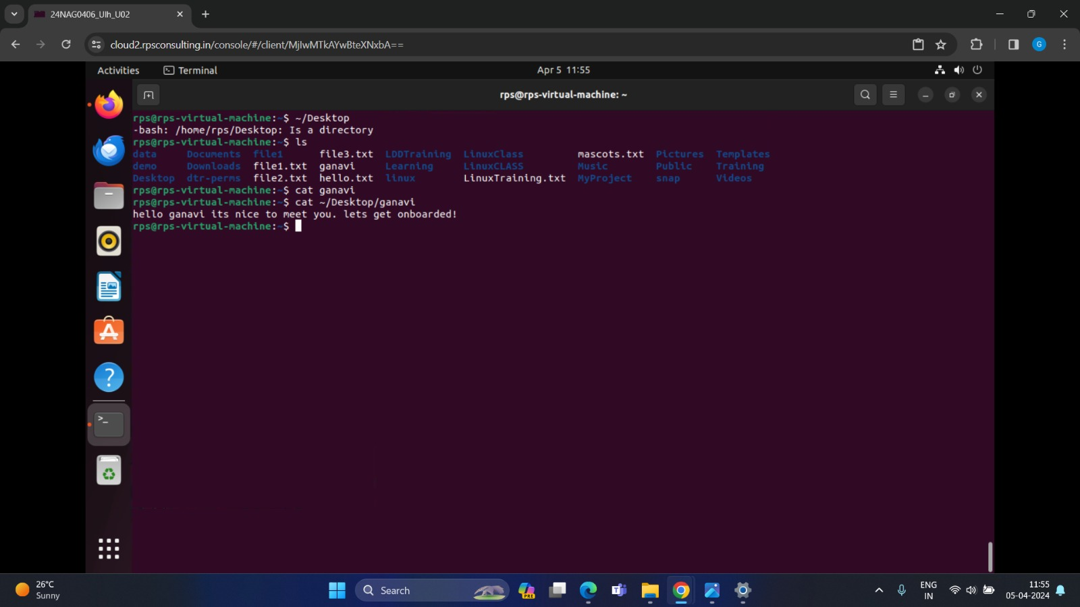
FILE APPEARING IN ANOTHER PERSON’S SYSTEM:

Slide 4
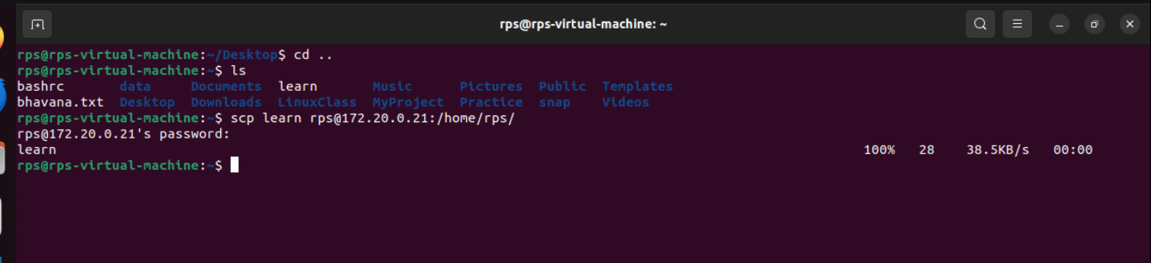
COPYING FILES TO OTHER PERSON’S SYSTEM:

Slide 5
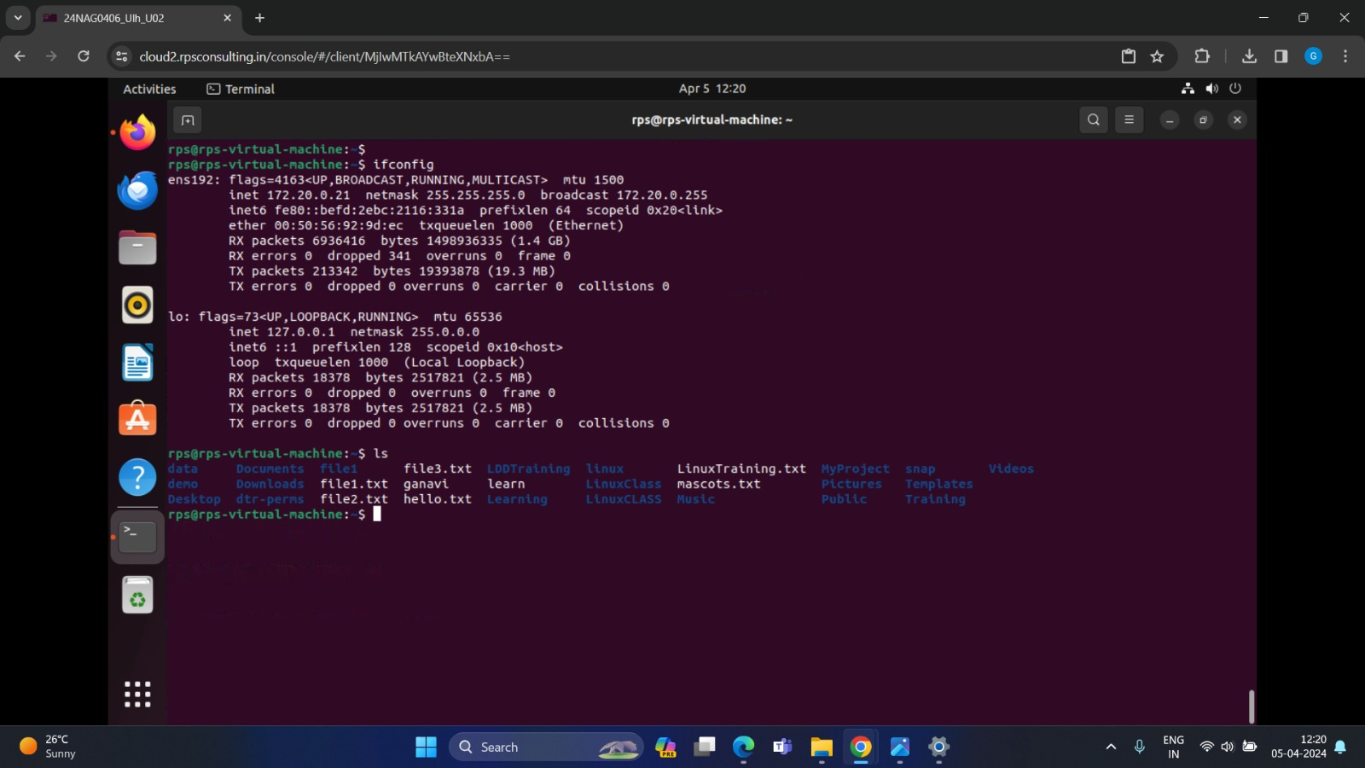
COPIED FILE PRESENT IN OTHER PERSON’S SYSTEM:

Slide 6
GIT
What is Git?
A distributed version control system (VCS) whose primary user interface is the Unix command line. It basically keeps a "non-human-readable" database of the files you put under version control ("track") and provides commands to access and update that database.
Graphical user interfaces, integration in Integrated Design Environments, and web platforms GitHub/GitLab/... have formed around the Git core software. The aim here is not to tell you every single Git command in existence or even to teach you all the functionality.
The aim is to familiarise you with the principles of version control, some good practices, and get you started on the practical matters.

Slide 7
SHELL SCRIPTING:
C-like syntax (uses { }’s)
Inadequate for scripting
--Poor control over file descriptors
--Can't mix flow control and commands
--Difficult quoting "I say \"hello\"" doesn't work
--Can only trap SIGINT
Survives mostly because of interactive features.
--Job control
--Command history
--Command line editing, with arrow keys (tcsh)

Slide 8
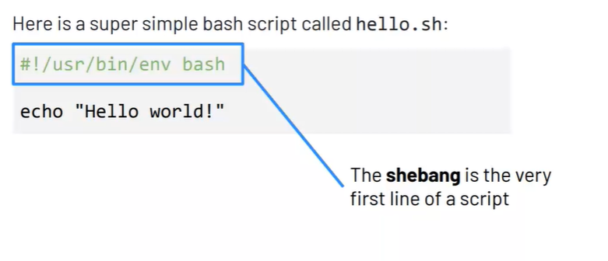

Slide 9
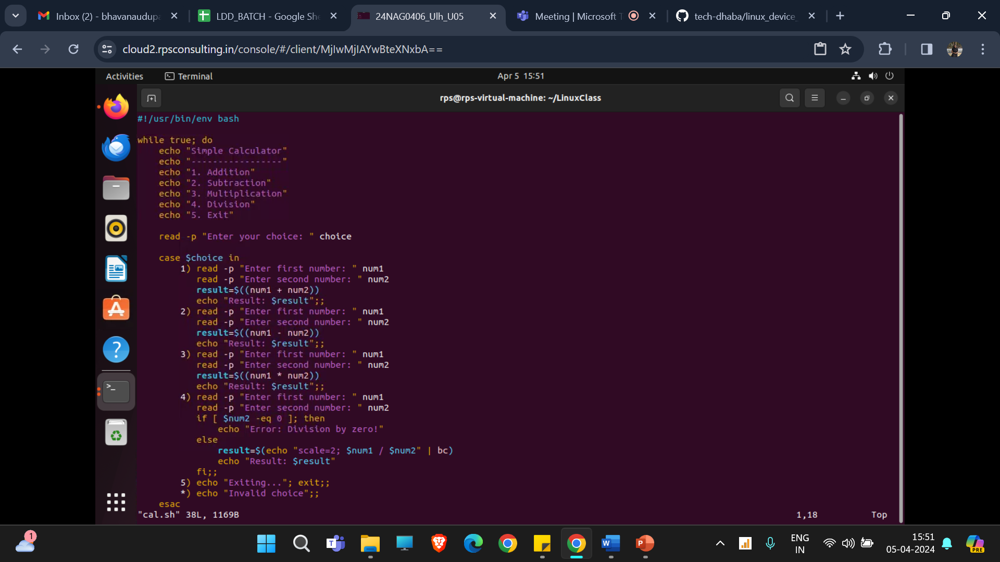
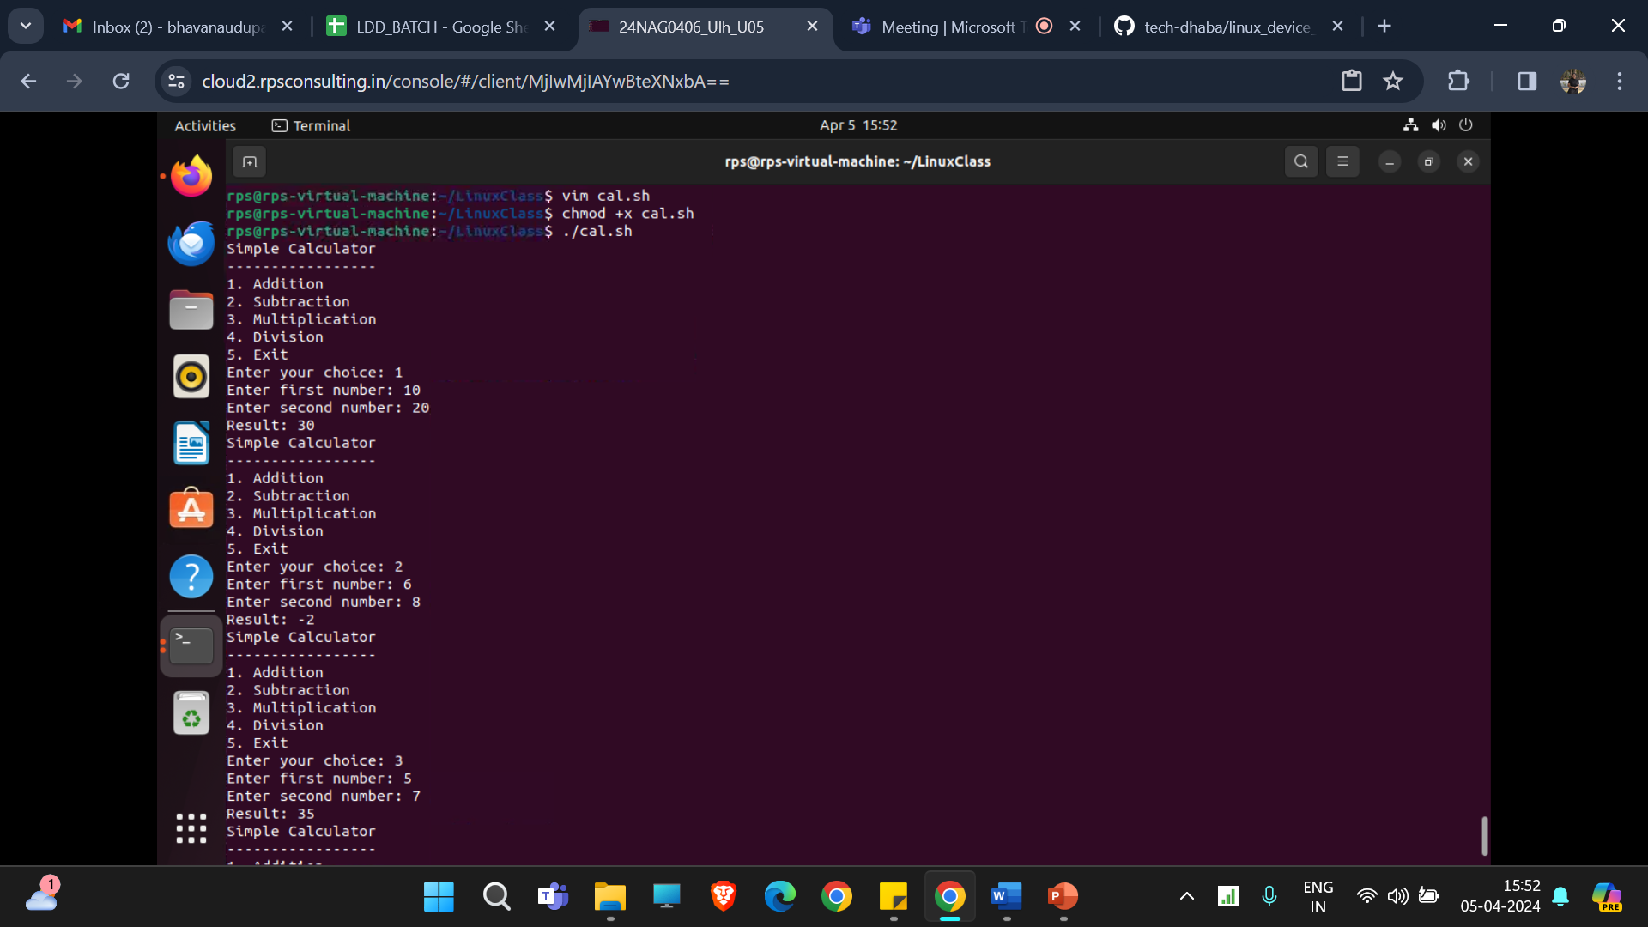
SIMPLE CALCULATOR:
vim cal.sh
./cal.sh

Slide 10


